Slide 1
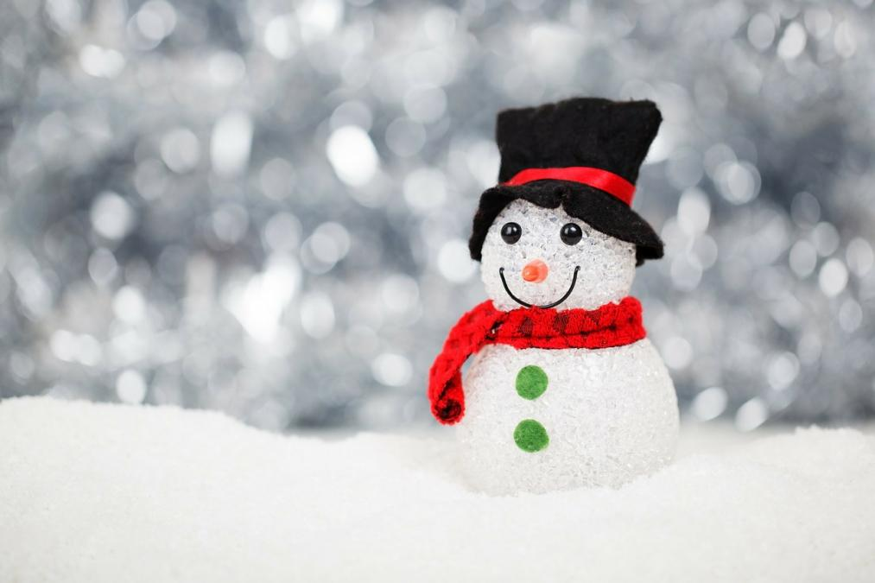
Ms. S’ Class
Classroom Newsletter
January 9th – 13th, 2023
Dates to Remember This Week
Dec 11th: 2-Hour Early Release
Classroom News
Happy weekend! We are now finished with our seventeenth week of school! I hope you all had a great weekend!
We have finished publishing our biographies and will start writing persuasive essays soon. We have begun learning about economics in America, as well as the solar system. We will continue multiplying decimals this week.
I hope you have a wonderful weekend!
Student of the Week
Zoey Sands
Zoey is great friend and loves to help others every chance she gets. She is respectful, polite, and kind to her classmates and staff!
Ms. S’ Class Email address: erika.smith@jcschools.us
Lawson Elementary School Website: https://www.jcschools.us/Page/19654 1105 Fairgrounds Rd Phone Number: 573-691-3175

Slide 2
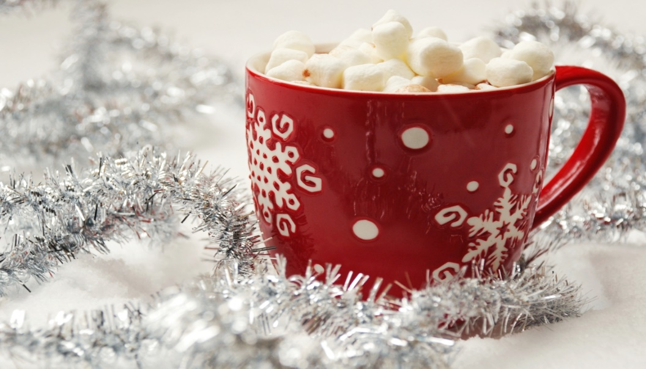
Breakfast Menu
Monday: Mini Cinnis
Tuesday: Tornado Variety
Wednesday: Cereal Variety
Thursday: Mini Maple Pancakes
Friday: Cereal Variety
What We’re Learning Next Week
Reading: Informative texts
Writing: Writing to inform
Math: Multiplying Decimals
Science: The Solar System & Beyond
Social Studies: Geography: Human Environment, Interactions, & Economics
Reminders
Don’t forget to sign your child’s reading log daily!
Lunch Menu
Monday: Hamburger/Cheeseburger
Tuesday: Chicken Tetrazzini
Wednesday: Hot Dog
Thursday: Taco Crunch
Friday: General Tsao Chicken

Slide 3
Some highlights from our week!

