Slide 1
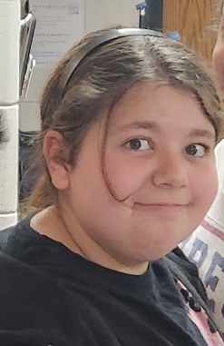
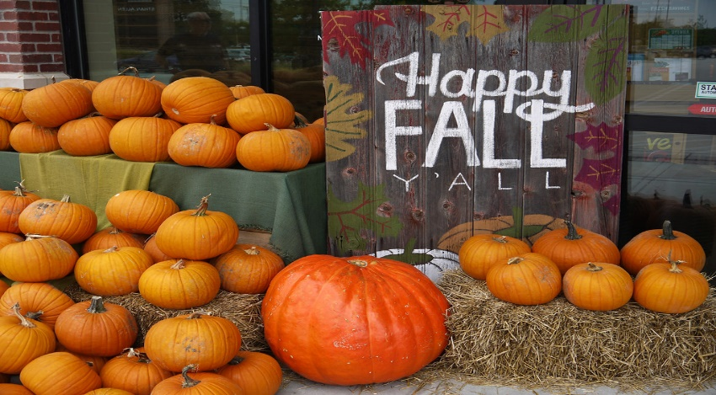
Ms. S’ Class
Classroom Newsletter
November 7-11, 2022
Dates to Remember This Week
Nov. 8th – Parent/Teacher Conferences
Nov. 10th - Parent/Teacher Conferences and Veteran’s Day Assembly
Nov. 11th – No School
Classroom News
Happy weekend! We are now finished with our tenth week of school! This week was a blast! We had a fun filled day on Monday with our Trunk or Treat and Halloween activities.
I was out sick for a lot of the week, but our substitutes both said that the students did a fantastic job this week!
Parent/teacher conferences are on Tuesday and Thursday, if for any reason you can’t attend at your scheduled time, please let me know ahead of time.
Veteran’s Day is on Friday, so if you have served, I just want to say Thank You!
Have a great weekend!
Student of the Week
Stormy Moayer
Stormy is a great friend to everyone around her. She is a joy to have in class and is always trying her hardest. She is determined and never gives up.
Ms. S’ Class Email address: erika.smith@jcschools.us
Lawson Elementary School Website: https://www.jcschools.us/Page/19654 1105 Fairgrounds Rd Phone Number: 573-691-3175

Slide 2
Breakfast Menu
Monday: Mini Cinnis
Tuesday: Pizza Bagel
Wednesday: Cereal Variety
Thursday: Tornado Variety
Friday: No School
What We’re Learning Next Week
Reading: Informative texts
Writing: Writing to inform
Math: Volume and measurement
Science: Interactions of Earth’s major systems
Social Studies: The road to the Civil War
Reminders
Nov 8th and 10th – Parent/Teacher Conferences
Nov 10th- Veteran’s Day Assembly
Nov 11th- No School
Don’t forget to come to Parent/Teacher Conferences!
Don’t forget to sign your child’s reading log daily!
Lunch Menu
Monday: BBQ Rib Sandwich
Tuesday: Chicken Tetrazzini
Wednesday: French Toast Sticks
Thursday: Chicken Nachos
Friday: No School

Slide 3
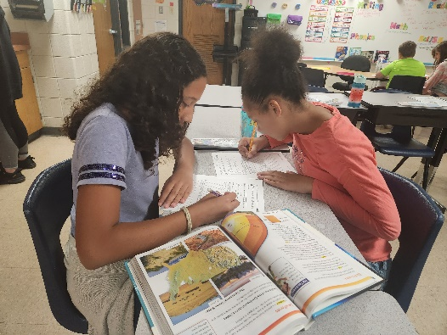
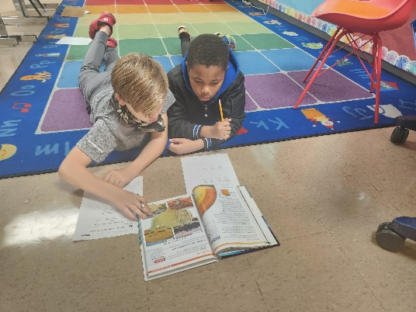
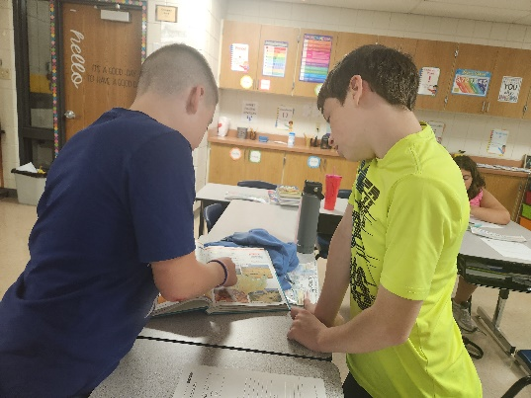
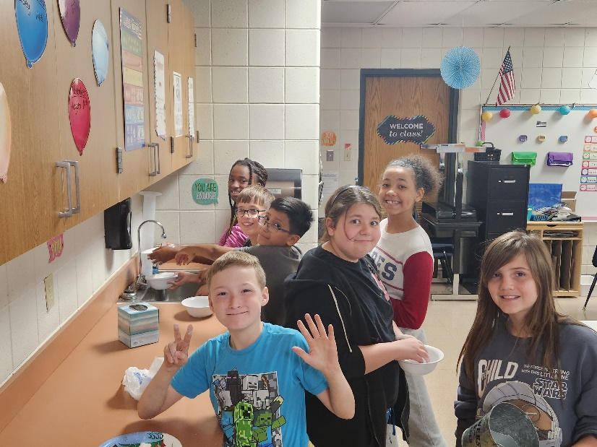
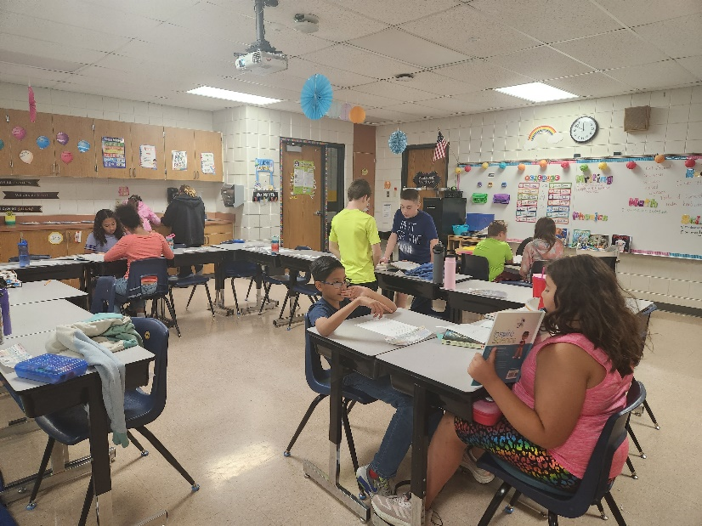
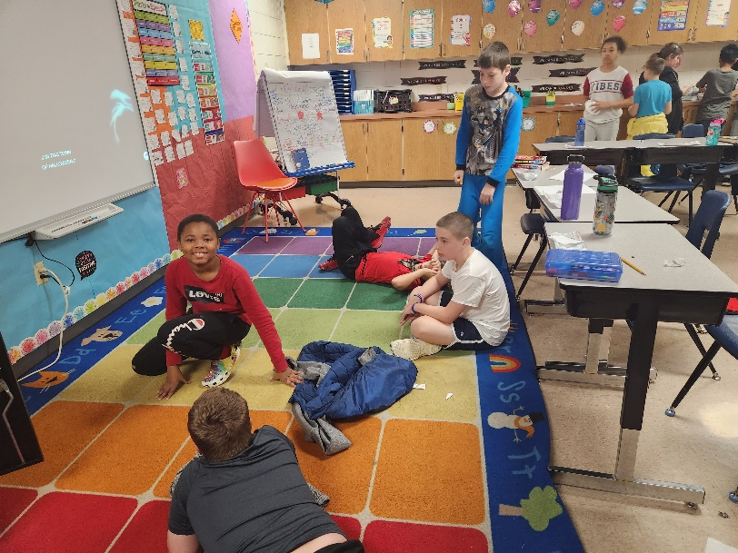
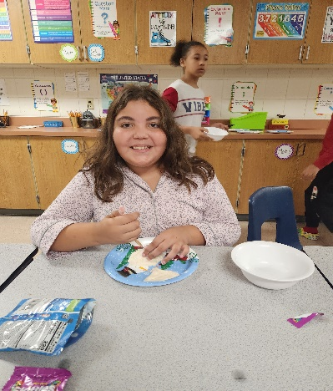
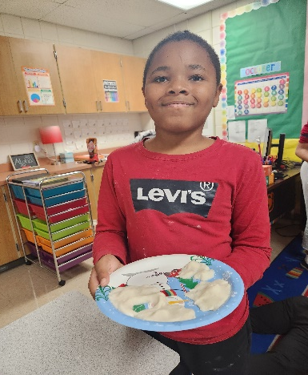
Some highlights from our week!

