Slide 1
SCHOOL READY

Slide 2
“School Ready” means…..
Cell phones turned off and put away
Call School’s Main Line 573-659-3200 if Need to Talk to Student
Teachers have phones in rooms or Phone in Main Office if Student Needs to Call Home
Students will have chromebooks to use
Earbuds/Headphones removed from ears and put away
Hats and head coverings removed and put away
Notes:
Students

Slide 3
“School Ready” means…..
Return greetings to adults “Hello” or “Good morning”
Every adult in our building will greet students as they arrive and leave!
Walk directly to Cafeteria for Breakfast and then Blazertime
Important for students to be on time to classes
Students will be marked tardy when late to school (if not b/c of bus) or late to classes
Be kind to one another, be good, and do good - Let’s make it a great day at LC!
Notes:
Students

Slide 4
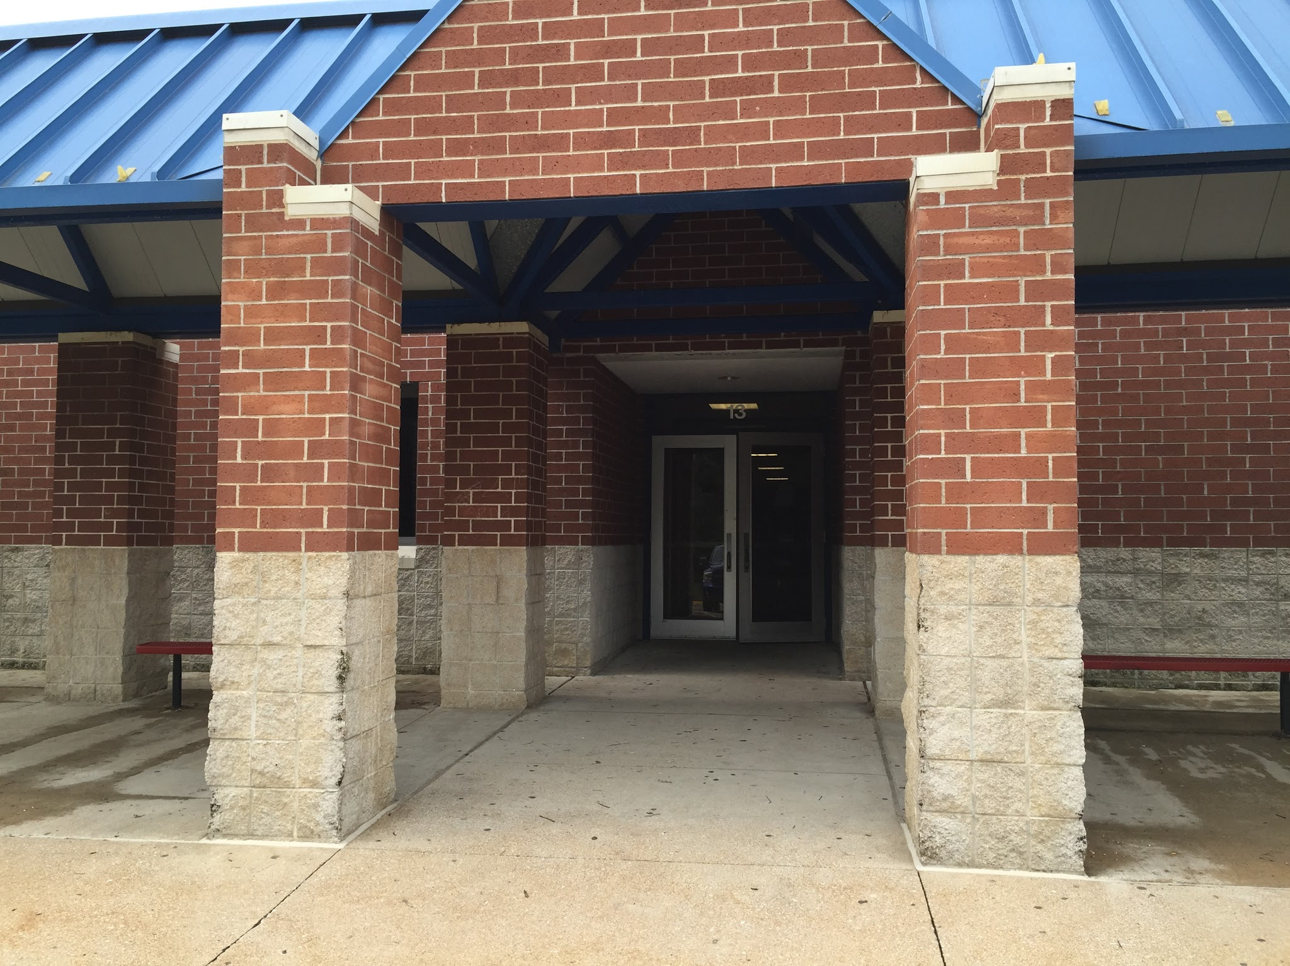
Arrival and Departure
Car Riders and Walkers-
Use Side Gymnasium Entrance
Bus Riders-
Use Front Main Entrance
Tardy Time: 8:50
Drop Off: 8:20-8:50
Pick Up: 3:50-4:00

Slide 5
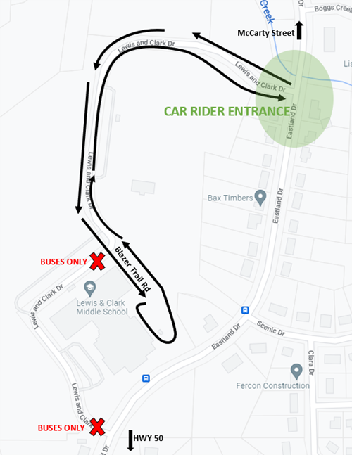
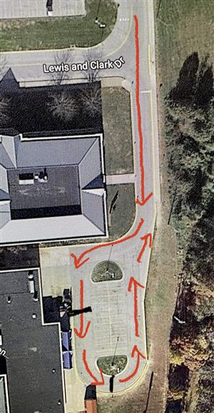
Arrival and Departure
Notes:
Students

Slide 6
Chromebook Expectations
Students will take chromebooks home daily.
Students are required to charge Chromebooks at home and return each day with a charged Chromebook ready for use in each classroom.
Chromebooks are for school use only.

Slide 7
Dress Code
Appropriate Dress Includes:
Nothing that is sexually explicit, vulgar, violent, or advocating illegal activities
No clothing that shows excessive amount of exposed skin, esp near private areas of body, or exposing undergarments
No caps, bandanas, hoods, or head coverings
Appropriate Dress for PE:
Athletic bottoms (shorts, sweatpants, leggings) with t-shirt and/or hoodie
Tennis shoes
No denim

Slide 8
Follow Us on Social Media!
Facebook: @lcmstrailblazers
LCMS Trailblazers PTO
Twitter: @LCtrailblazers
@JCSchools_
Instagram: lcmstrailblazers
lcmspto

