Slide 1
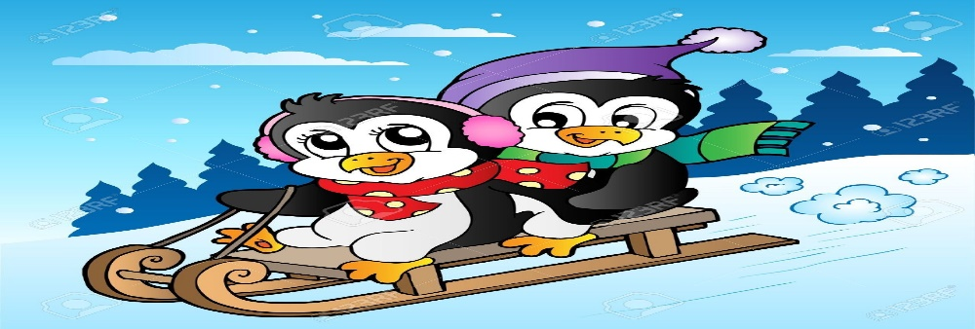
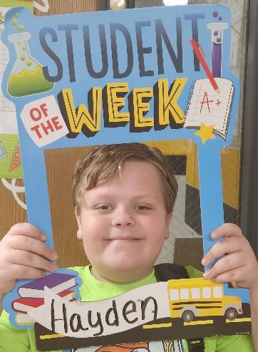
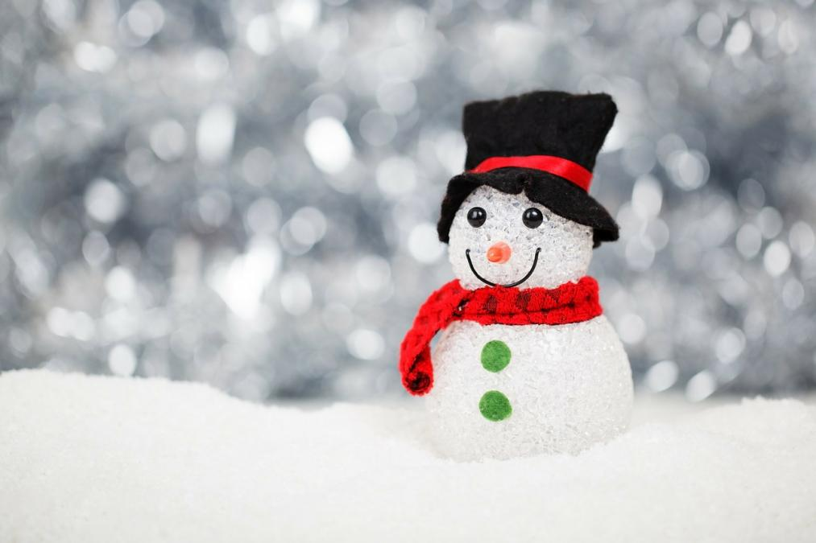
Ms. S’ Class
Classroom Newsletter
January 23rd – 27th, 2023
Dates to Remember This Week
26th- Magician Assembly for qualifying students
Classroom News
Happy weekend! We are now finished with our nineteenth week of school! I hope you all had a great weekend!
We have started learning how to write persuasive paragraphs, and we did a fantastic job on our ELA assessments!
We are still learning about economics in America, as well as the solar system. We will be dividing decimals this week.
I hope you have a wonderful weekend!
Student of the Week
Hayden has been doing a fantastic job of following expectations and working his hardest on everything we have been doing.
Ms. S’ Class Email address: erika.smith@jcschools.us
Lawson Elementary School Website: https://www.jcschools.us/Page/19654 1105 Fairgrounds Rd Phone Number: 573-691-3175

Slide 2
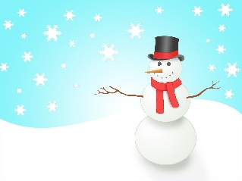
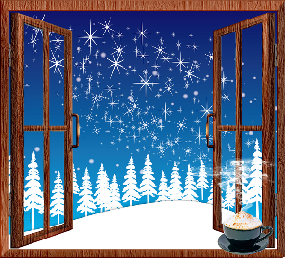
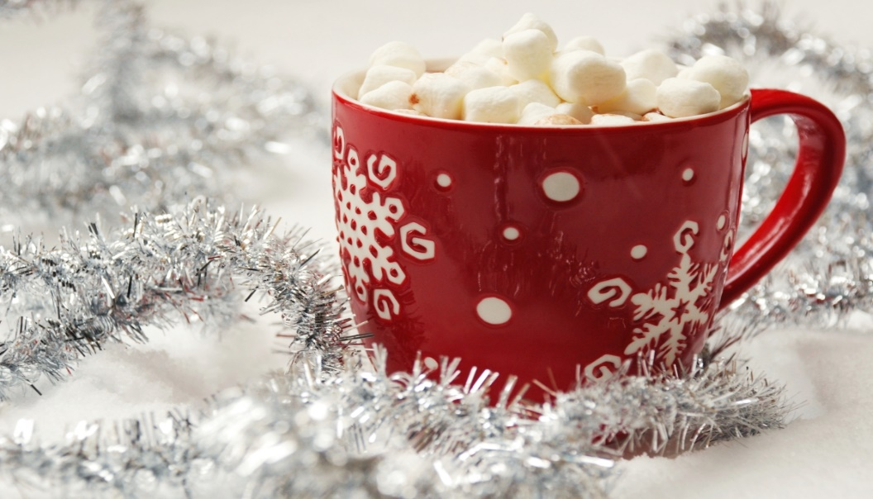
Breakfast Menu
Monday: Mini Waffles
Tuesday: Pizza Bagel
Wednesday: Cereal Variety
Thursday: Pancake Stick
Friday: Cereal Variety
What We’re Learning Next Week
Reading: Opinion texts
Writing: Writing to persuade
Math: Multiplying Decimals
Science: The Solar System & Beyond
Social Studies: Geography: Human Environment, Interactions, & Economics
Reminders
Don’t forget to sign your child’s reading log daily!
Lunch Menu
Monday: Chicken Nuggets
Tuesday: Grilled Cheese
Wednesday: Chicken Cheese Taquito
Thursday: Manwich w/ Tostito Scoops
Friday: Bosco Breadsticks

Slide 3
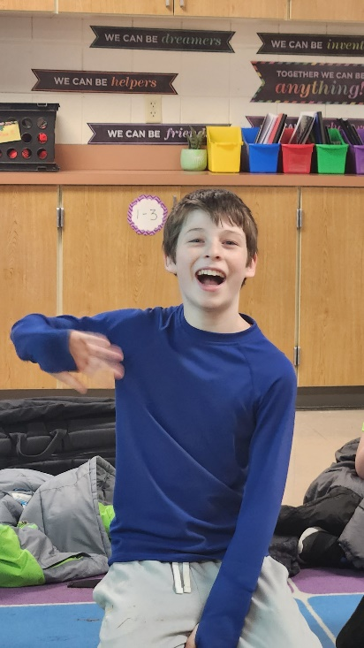
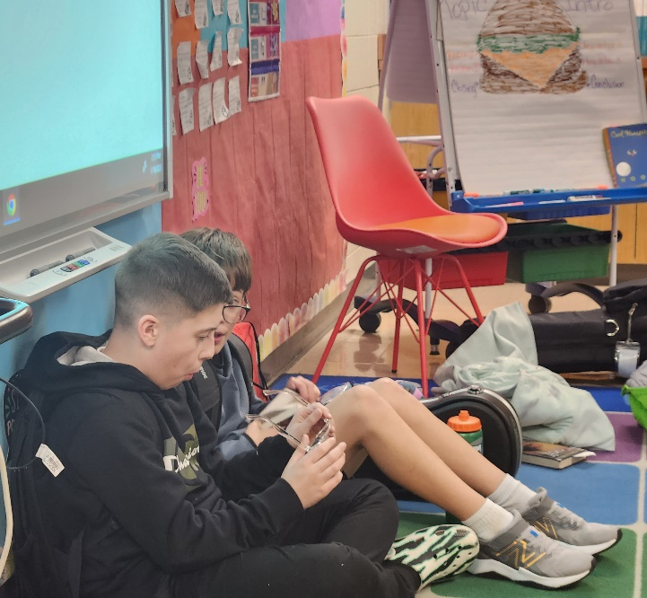
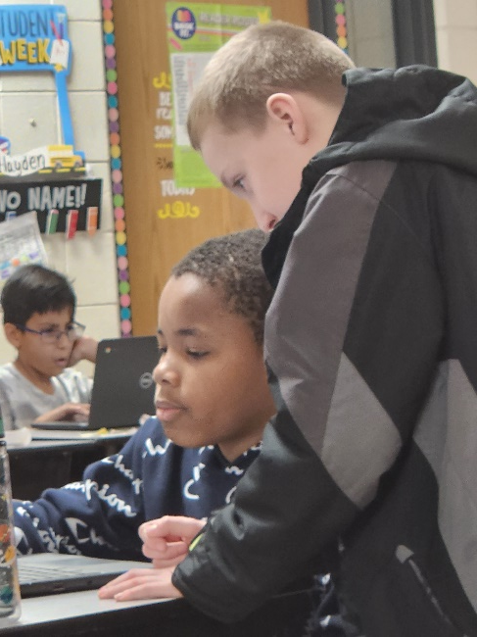
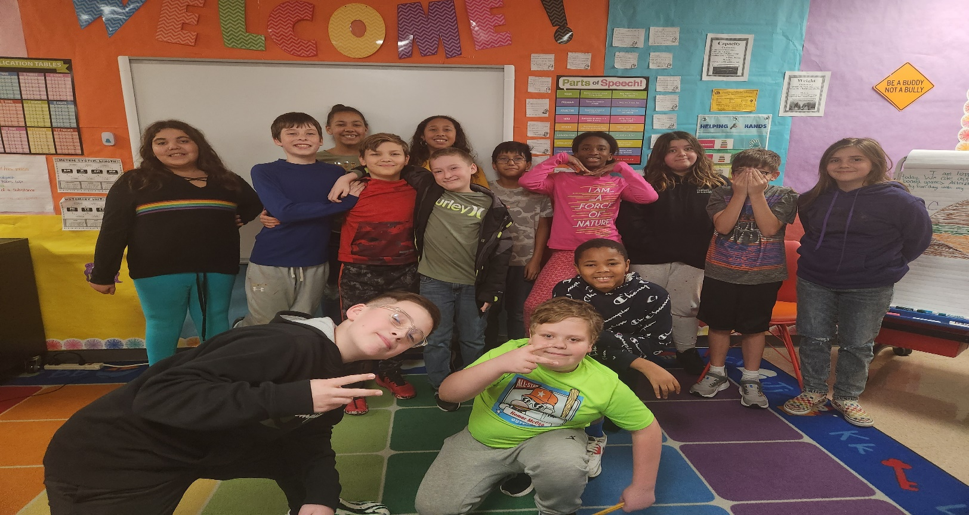
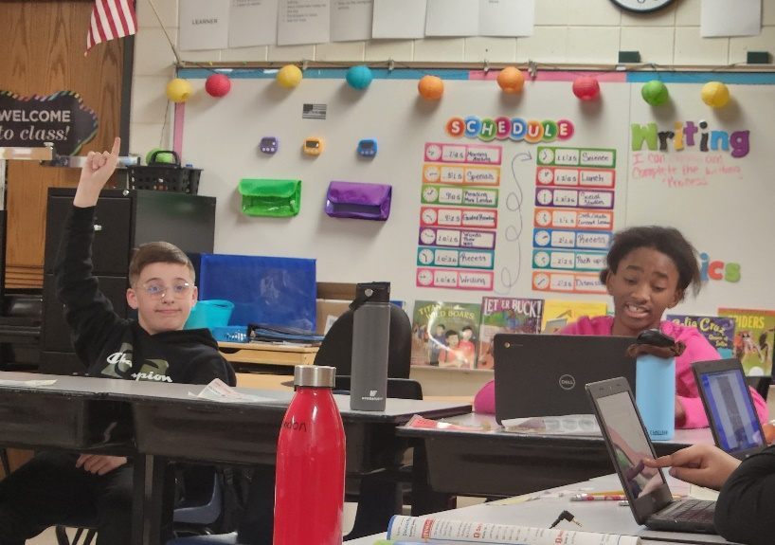
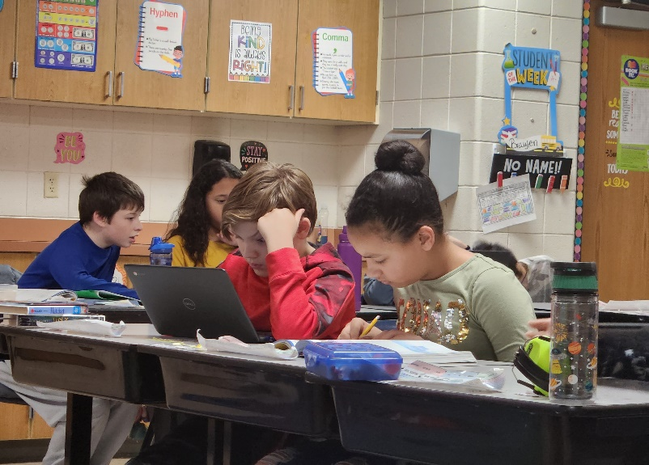
Some highlights from our week!

